Slide 1

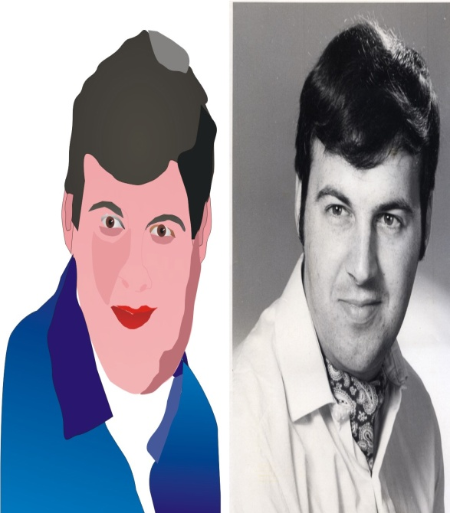
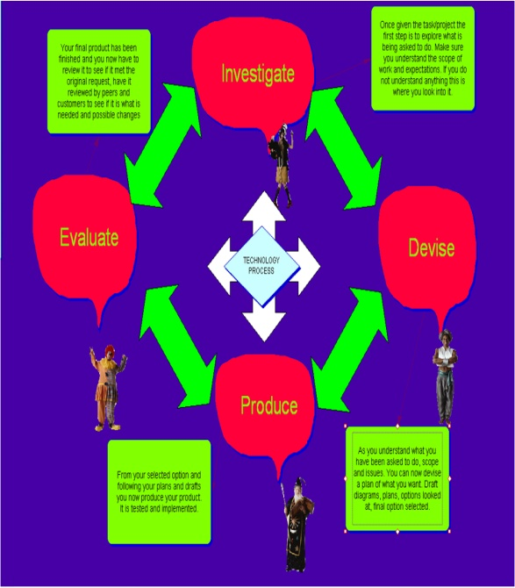
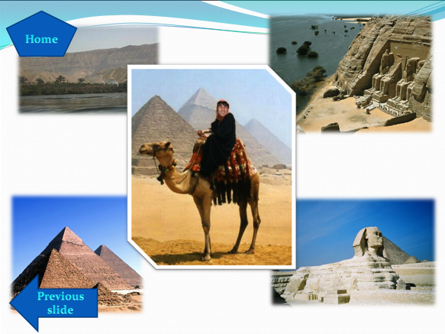
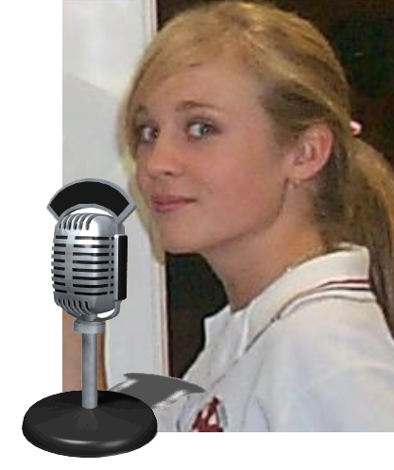

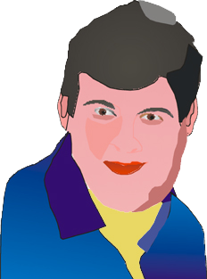
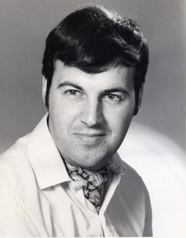

Welcome to Multimedia
Web Page
Multimedia Gizmo
Task 2
Image Manipulation
Task 1 Inspiration
Peter J Faulks
Information Communication Technology
Multimedia
Task 4
Around The World
Task 3
Radio Advert
Task 5
Portfolio
Click Mouse to start

Slide 2

Web Page
Multimedia Gizmo
Students create a simple linear web page about a gizmo multimedia device such as a portable entertainment system.
Image Manipulation
Students work on modifying and manipulating images to suit the desired result. using filters and effects. Students learn about image types and formats and work with a variety of software packages to create a cartoon avatar
Inspiration
Using the Technology Process
Students create a chart in Inspiration
and a Poster A1 size.
Faulksy’s
Information Communication Technology
Multimedia
Around The World
Students take themselves on a tour of the world visiting at least four (4) continents and six (6) countries.
Radio Jingle
Students create a radio quality advertisement jingle with clip tracks, effects such as fade in/out, echo or warble etc. and add voice over to create a 30 second jingle.
Portfolio
Students put together a collection of their work in a presentation package
Introduction

Slide 3
About
Multimedia Year 10
Multimedia will introduce you to the broad range of software and hardware used in Upper School IT and Business subjects.
It will also help you understand how to use the complete “Technology Process” when tackling the practical problem-solving challenges found in any Technology & Enterprise subject.
COURSE DESCRIPTION: Multimedia is the perfect place to blend together your creative and artistic flair with your logical and systematic techno-thinking.
Students will explore digital photography and may use webcams, scanners, microphones etc. to create fantastic multimedia presentations including 2D animations, vector and bitmap graphics, interactive multimedia presentations which may include animated images, movies, claymations, animated diagrams, concept maps, photo morphing, photo imaging, audio files, web pages and simple graphics programming.
About

Slide 4
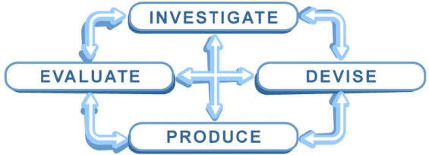
Inspiration
Using the Technology Process
Students create a chart in Inspiration
and a Poster A1 size.
Software includes Inspiration, In-Design, Photoshop,
Word or Publisher
Devise: Sketch and plan your layout
Investigate: Look up the technology Process
Produce: Create an Inspiration chart and poster of the Technology
Produce: Using Inspiration create a diagram that covers the Technology Process for Multimedia
Produce: Using any suitable software create a poster in A1 size.
Evaluate: Evaluate your efforts
Inspiration

Slide 5
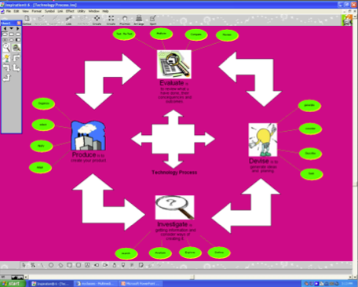
Inspiration
Inspiration

Slide 6

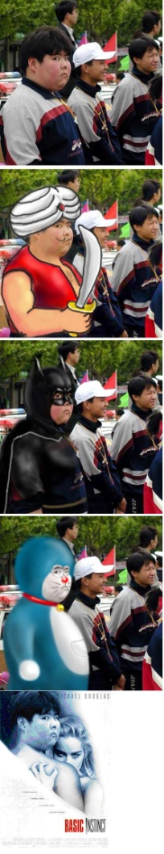
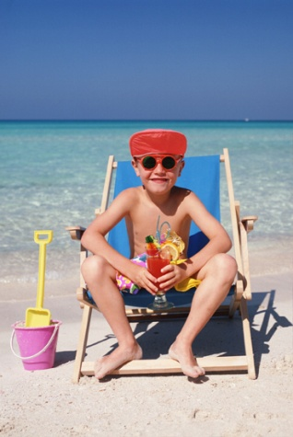
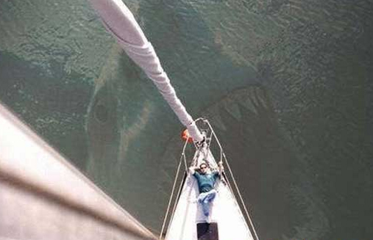
Image Manipulation
Students work on modifying and manipulating images to suit the desired result. using filters and effects. Students learn about image types and formats and work with a variety of software packages
Software includes Photoshop, Illustrator, Paint or Draw
This task includes creating vector graphics from bitmap images and transforming images for post production work.
Images

Slide 7


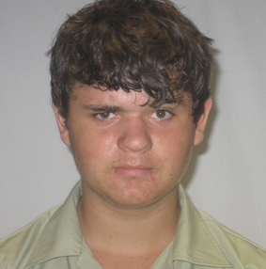


Radio Advert
Students create a radio quality advertisement jingle with clip tracks, effects such as fade in/out, echo or warble etc. and add voice over to create a 30 second jingle.
Students write their own script and choose their own music imported from CD, MP3 players or the Internet using cut and paste.
Software includes Sound Booth, Audacity.
Students also create a jaw talk effect using image manipulation and audio
Software includes Photoshop, Illustrator Flash, or Rave.
in Flash or Rave
Radio Jingle

Slide 8

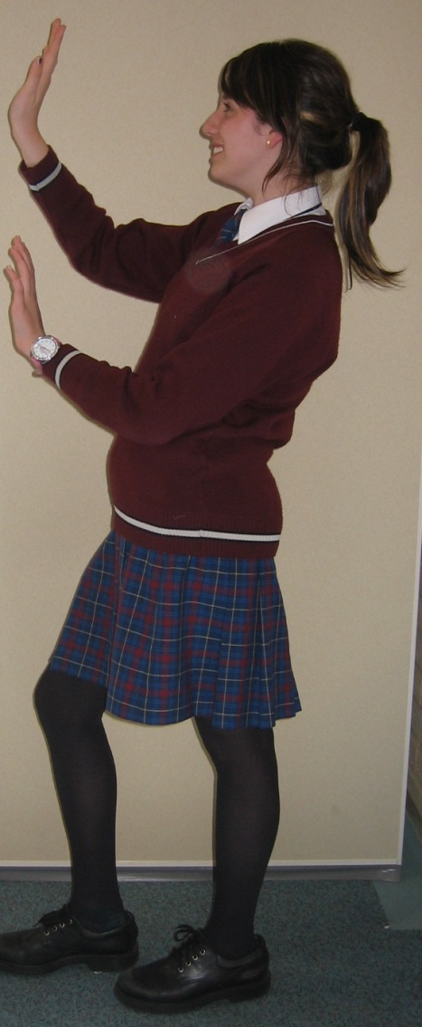
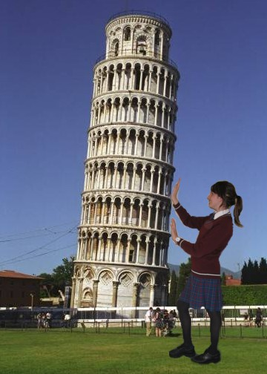
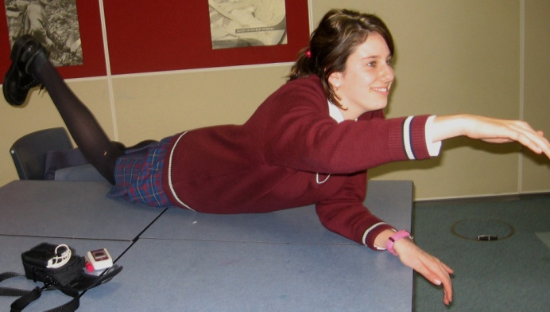
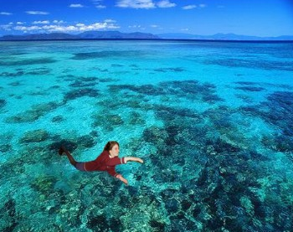

Slide 9
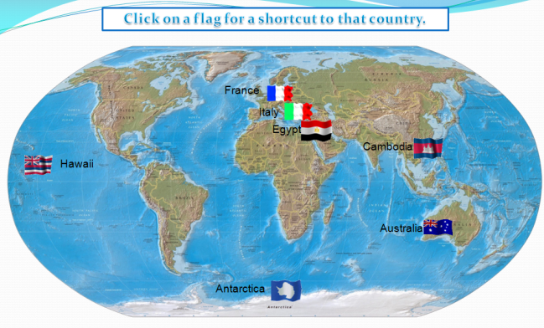
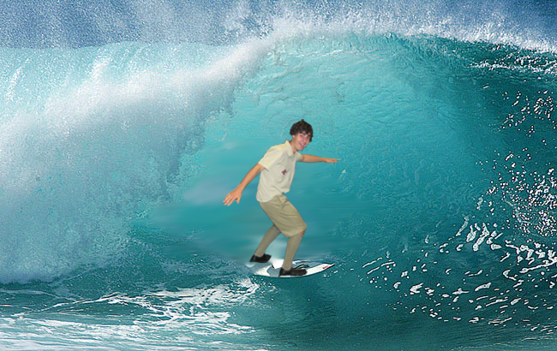
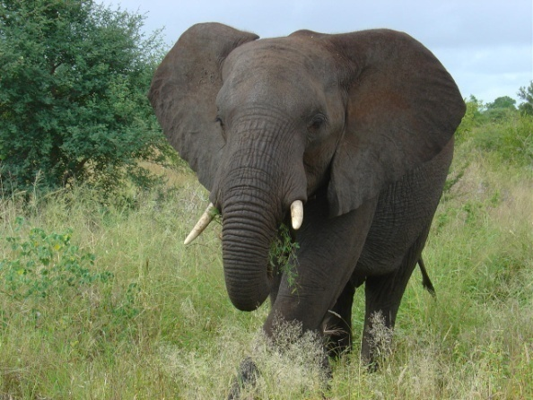

Around The World
Students take themselves on a tour of the world
visiting at least four (4) continents and six (6) countries.
Software includes Photoshop, PowerPoint and use of a camera
The slide show must include a picture of the world with flying links to each destination and hyperlinks to countries
In each place visited they must include a shot of themselves on location and give details of currency, language, climate and culture.
Around The World

Slide 10
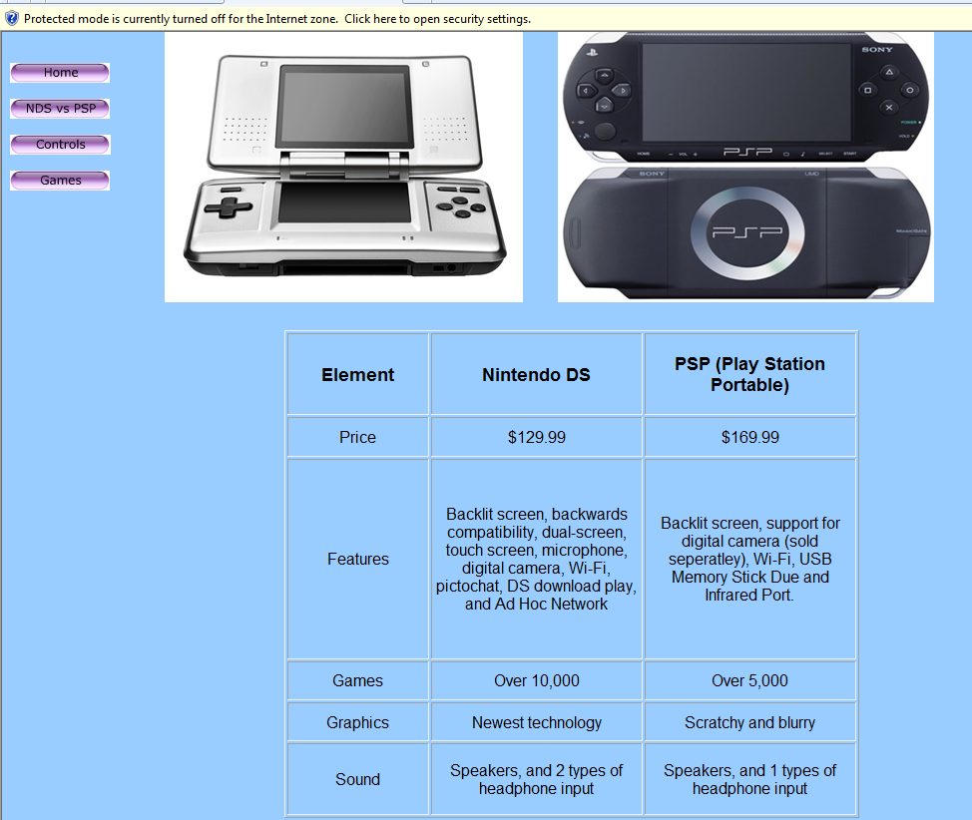
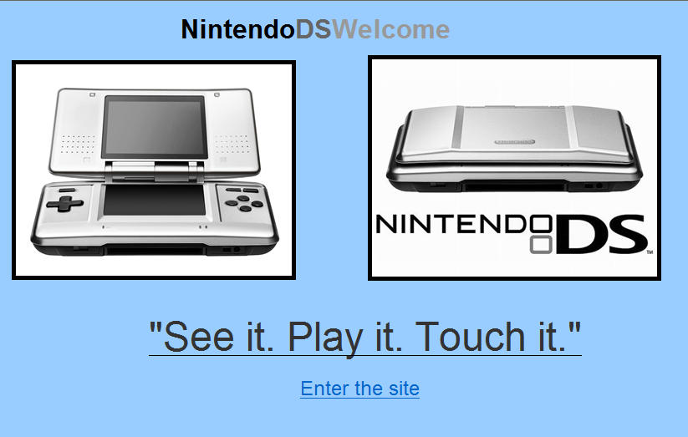
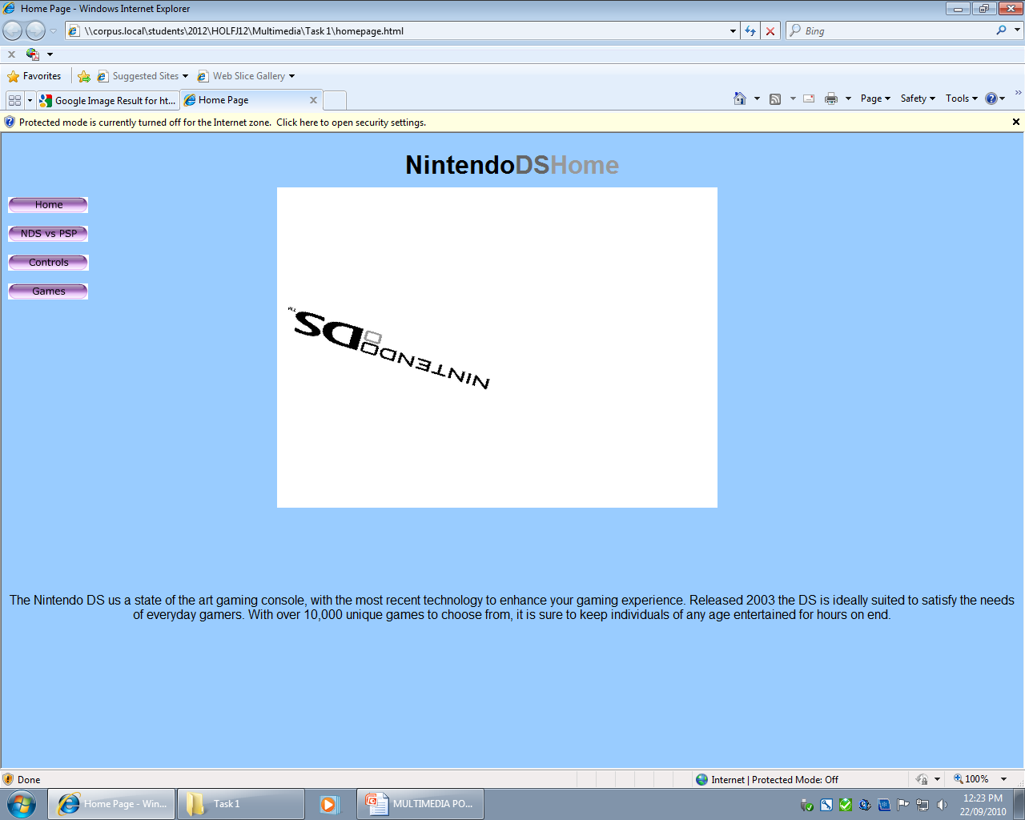
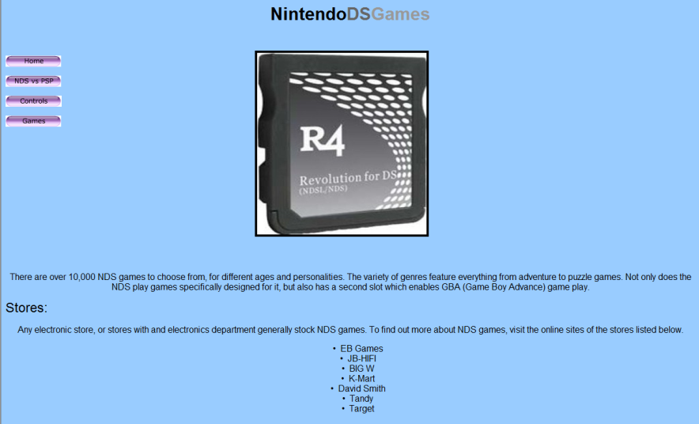
Web Gizmo Page

Slide 11

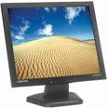
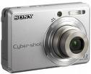
Web page Gizmo
Your task is to create a simple linear web page about a gizmo multimedia device such as a portable entertainment system.
Software will include Dreamweaver, Flash and Fireworks
You could show a multimedia home entertainment set up (LCD, Laser TV or Plasma TV with surround sound etc.) Blackberry, Bluray or DVD portable unit or any multimedia type gizmo that you want to demonstrate.
Your site MUST include how to use the device and should use digital convergence i.e. uses a range of media from one device such as a mobile phone + camera or MP3 player with video.
Gizmo

Slide 12
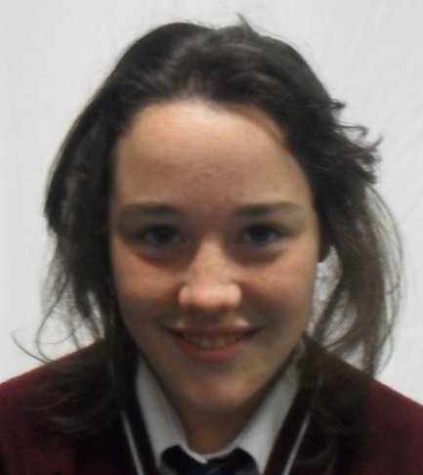
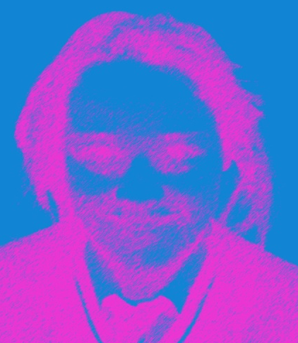

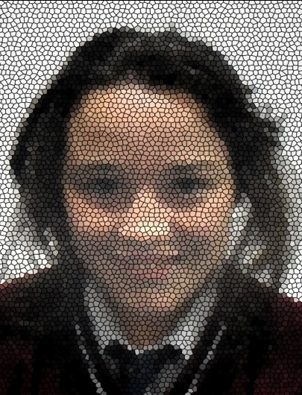
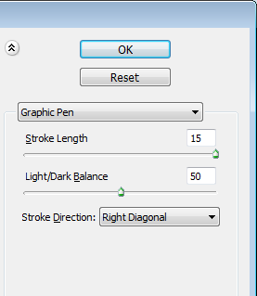
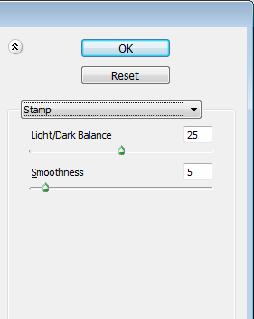
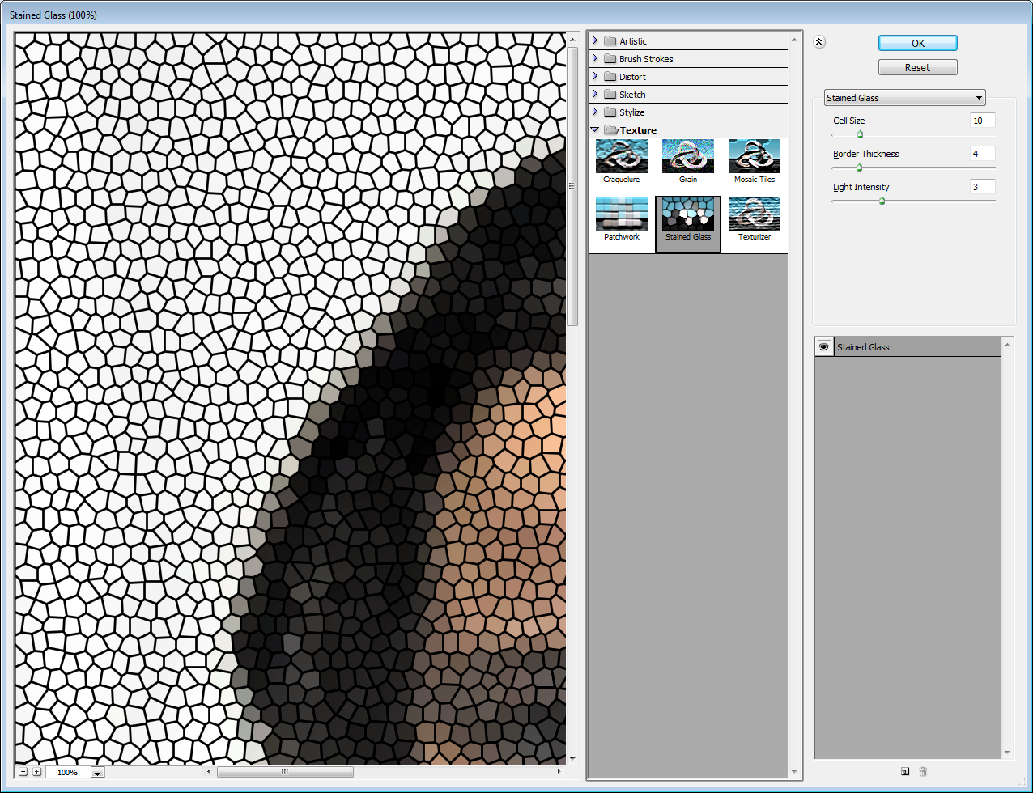
Image Manipulation
Original Image
Colour Graphic Pen
Stamp
Stained Glass

Slide 13
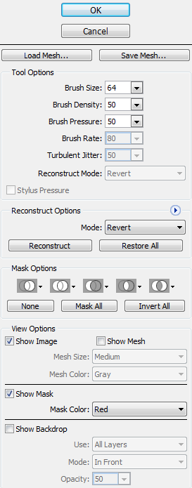
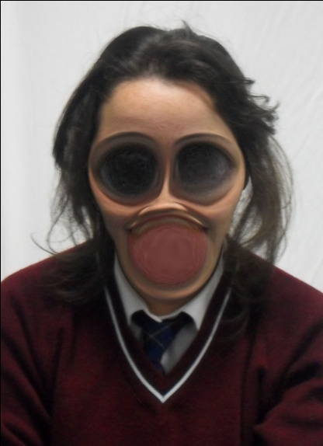
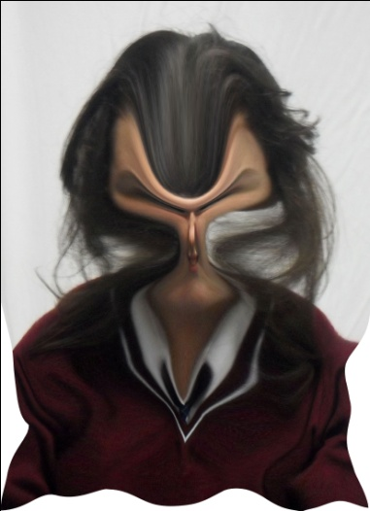
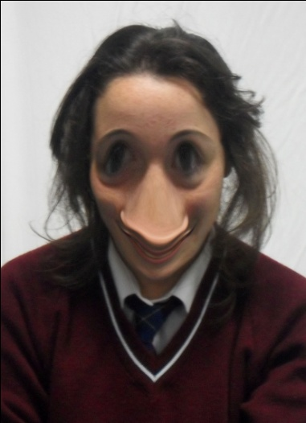
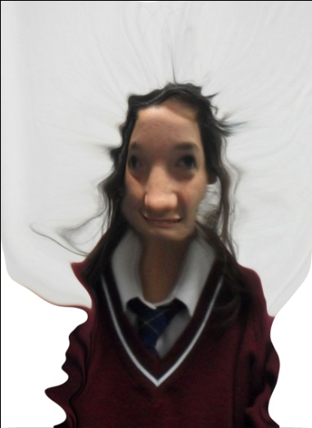
Liquefying Images

Slide 14
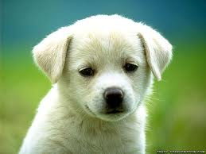

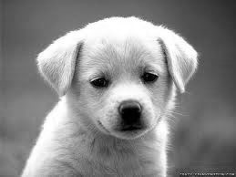

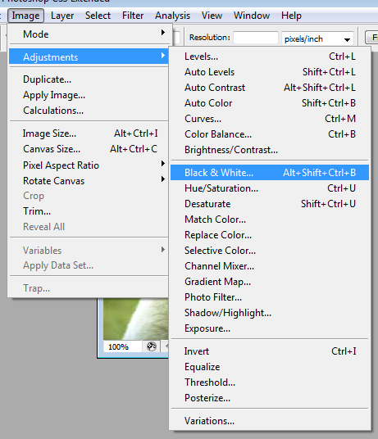
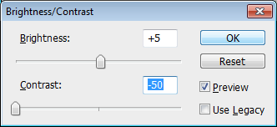
Image Manipulation
Black and White
Original Picture
Change of Contrast
Cropped

Slide 15
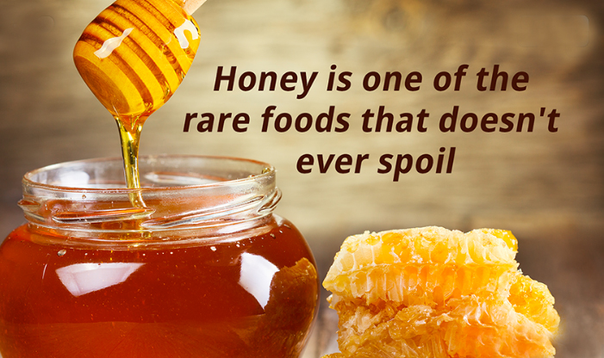
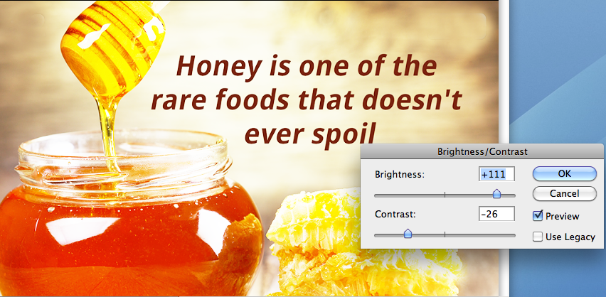
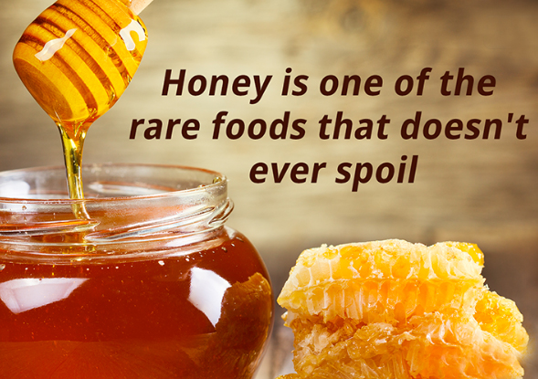

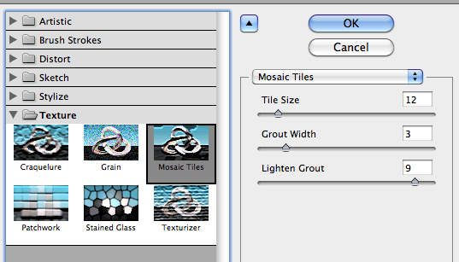
Image Manipulation
Change of Contrast
Original Picture
Effect
Cropped

Slide 16

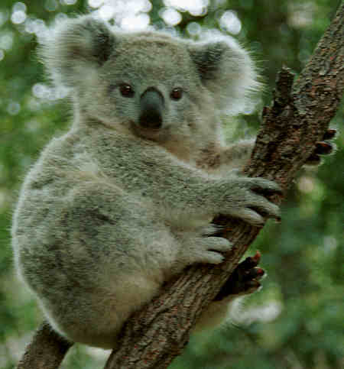
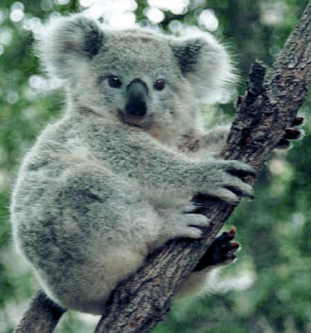
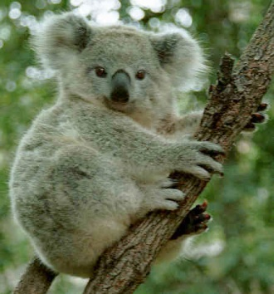
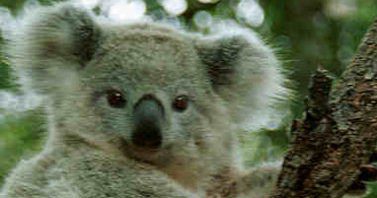
original
Screen, soft light layers
Less contrast
Modification crop

Slide 17
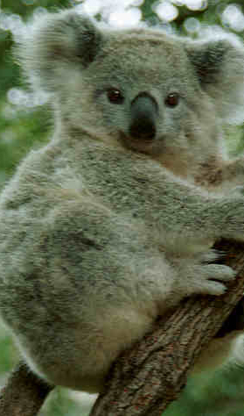
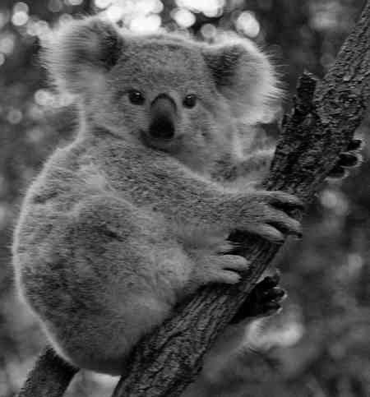

original
Modification crop
Black and white
more contrast

Slide 18








original

Slide 19






original

Slide 20





Filter Effects
CONTENT
CRAQUELURE
RETICULTATION
ORIGINAL IMAGE

Slide 21







Image Manipulation - Filters
Original
Cutout
Glowing Edges
Stained Glass

Slide 22






More Image Manipulation - Filters
Coloured Pencil
Neon Glow
Torn Edges

Slide 23





Original
Less Contrast
Crop
Black and White

Slide 24


CARTOON FACE
CONTENT
Original

Slide 25




Slide 26




Slide 27

Multimedia Samples
By Romelle Menezes

Slide 28

Coral Draw
File size: 784 KB
Dimensions: 4031 x 3035
Format: JPG Image
Location: H:\Multimedia\Multimedia Samples

Slide 29


Cartoon Face

Slide 30




Slide 31










Portfolio
Students put together a collection of their work in a presentation package
Software will include Power Point
Poster
Image Manipulation hair added to photo
Image Manipulation photos merged
Image Manipulation photos merged
Portfolio

Slide 32

Animation

Slide 33








The End
Thank you, if you have any more questions
please ask the teacher Mr Peter Faulks

Slide 34


The End
Thank you, if you have any more questions please ask the teacher

Slide 35
Template

